Slide 1
Discovering Recommendation Systems with Amazon’s Dataset
Understanding algorithms and data behind recommendations

Slide 2

Presentation Overview
Introduction to Recommendation Systems
Recommendation systems are crucial for enhancing user experiences in digital platforms by personalizing content and suggestions.
Amazon Dataset Overview
Amazon’s data serves as a rich source for studying user behavior and product recommendations, highlighting its structure and importance. However, this dataset doesn’t have any user centric features, hence, shaping the approach used.
Algorithms for Recommendations
Collaborative Filtering
Collaborative filtering utilizes user behavior and preferences to recommend items based on similar users' choices.
Content-Based Filtering
Content-based filtering recommends items based on the attributes and features of the items themselves, independent of user behavior.
Hybrid Methods
Hybrid methods combine collaborative and content-based approaches to enhance recommendation accuracy and user satisfaction.

Slide 3
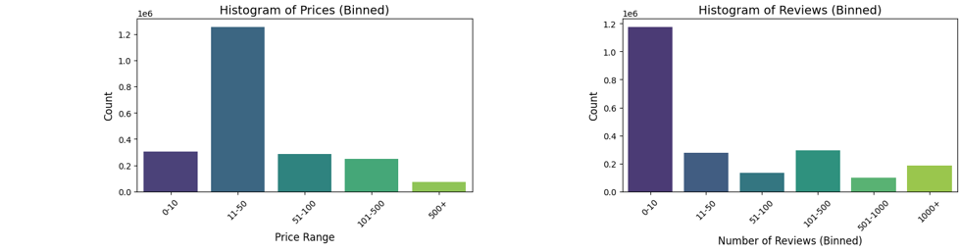
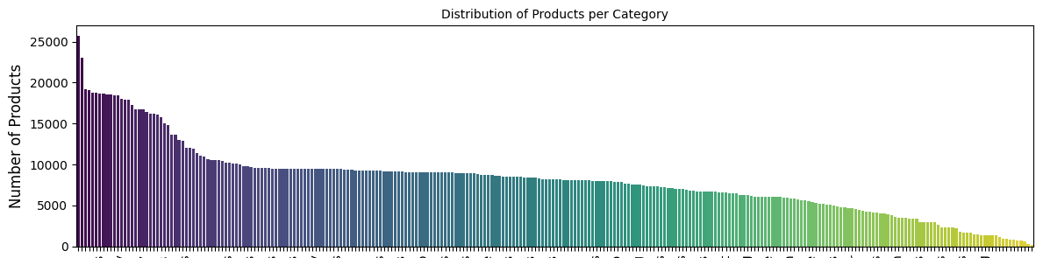
Overview of the Amazon Dataset
Lack of User Interaction Data
The dataset lacks information regarding user interactions with different products, which could aid in analyzing consumer behavior.
Features included
0 asin: Product ID
1 title: Description
2 imgUrl
3 productURL
4 stars
5 reviews
6 price: Discount
7 listPrice:
8 categoryName
9 isBestSeller
10 boughtInLastMonth

Slide 4
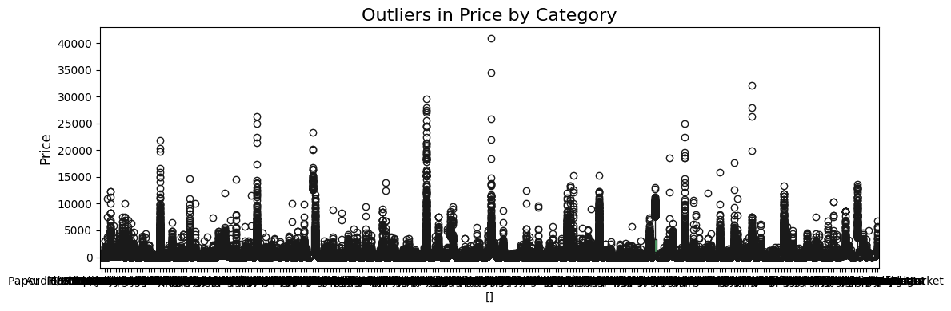
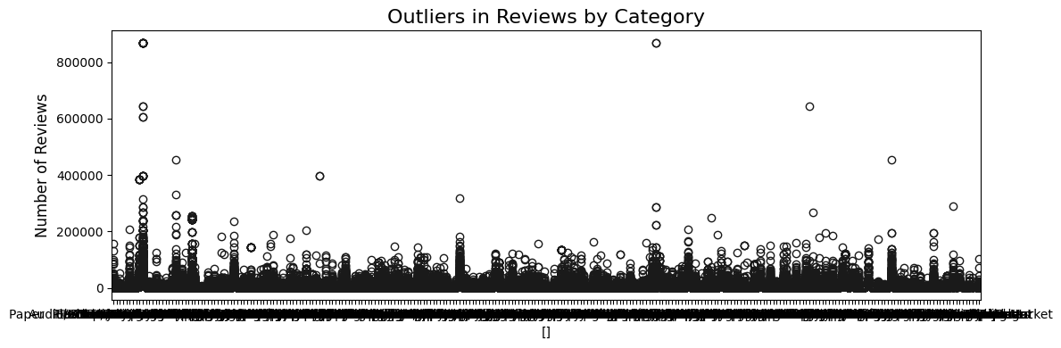
Overview of the Amazon Dataset
To Explore Further
Notes:
The Amazon dataset contains large-scale data on user interactions with products, including ratings, reviews, and purchase history. This dataset is invaluable for analyzing user preferences and building effective recommendation models.

Slide 5
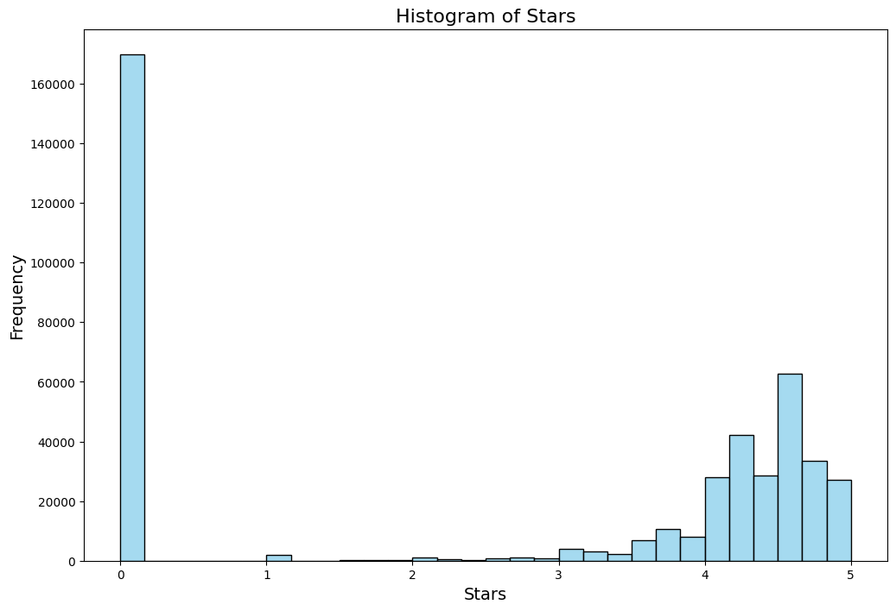
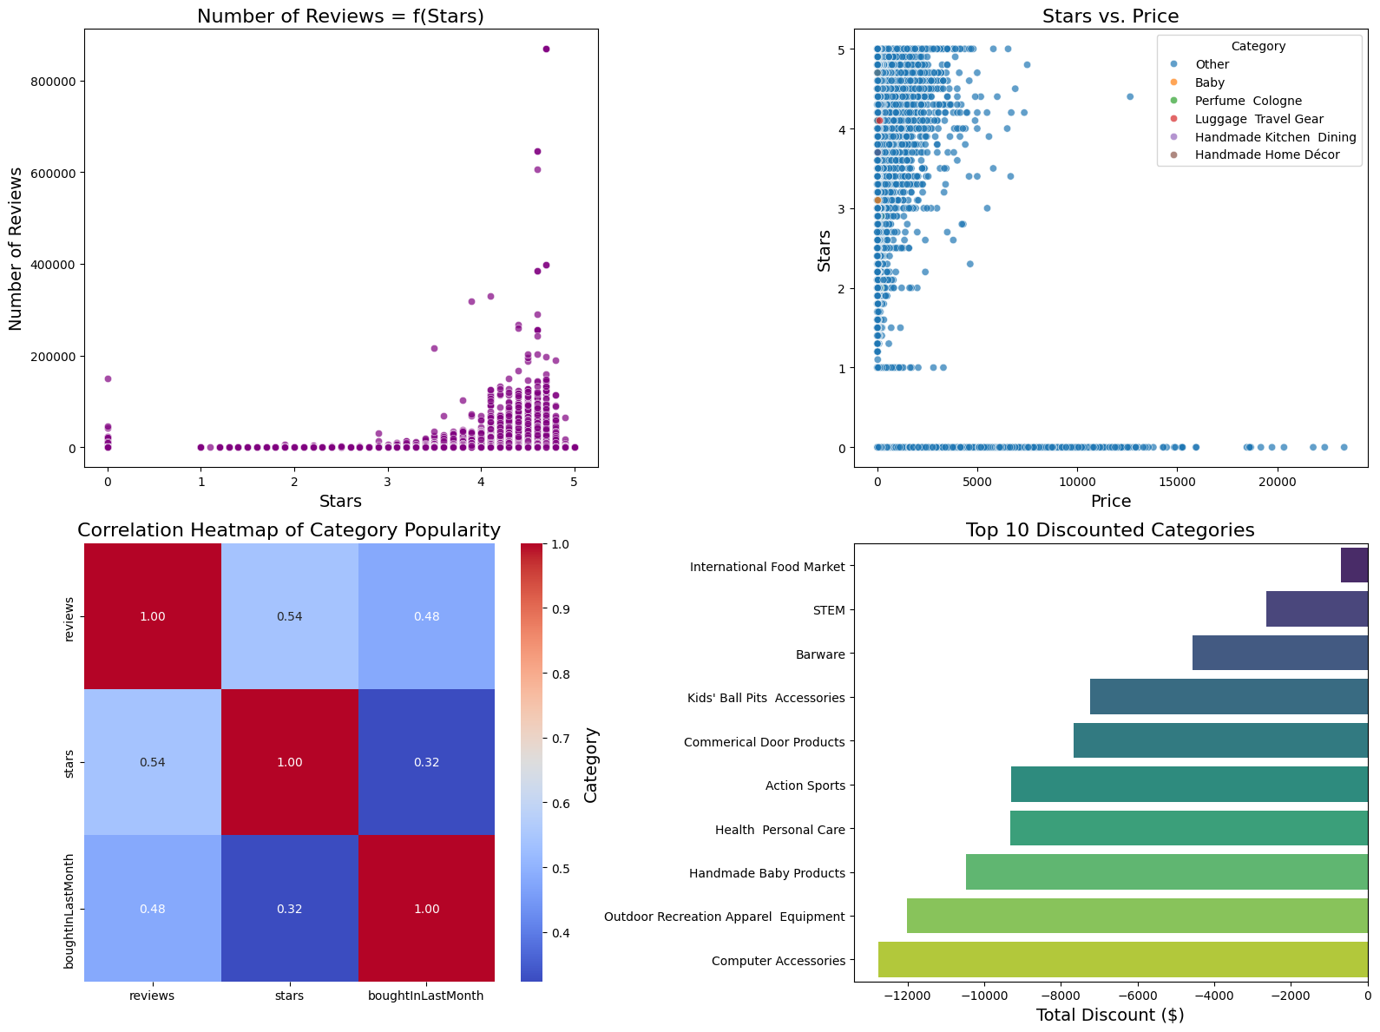
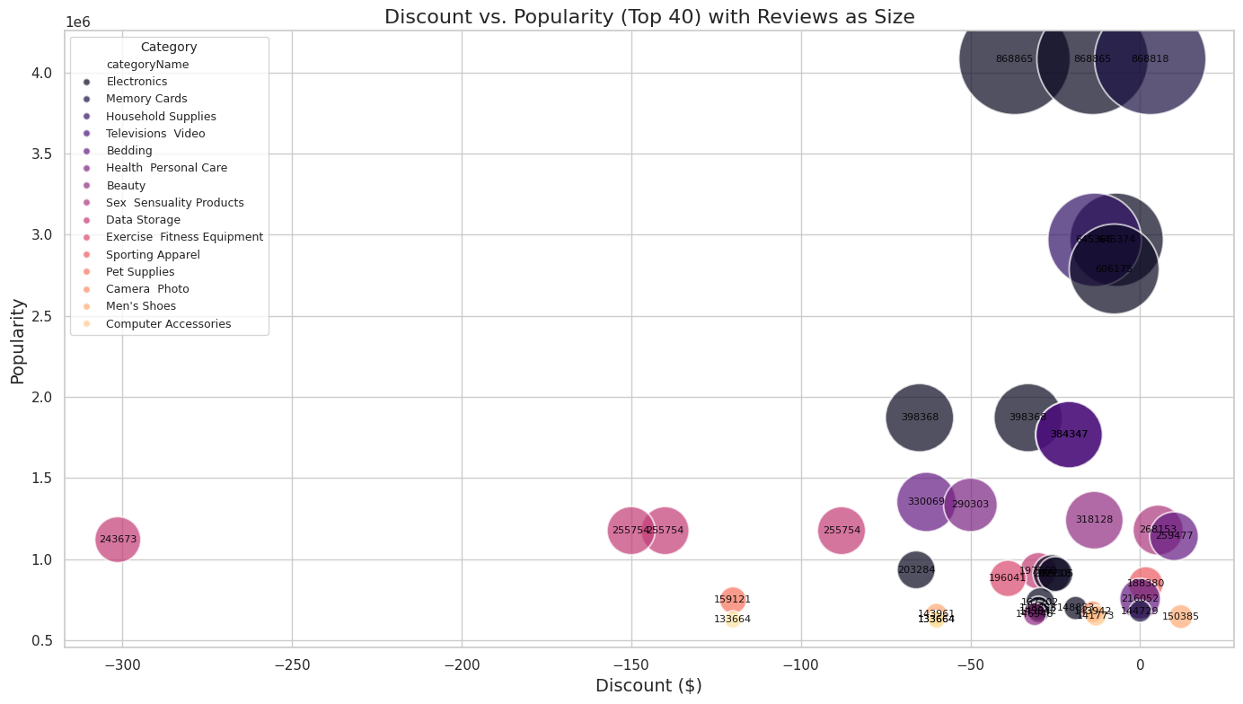
Overview of the Amazon Dataset

Slide 6
Data Preprocessing & Feature Engineering
Summary of New Features:
Discount Analysis: Computed the actual discount value and percentage for each item.
Title Length: Assessed the length of every product title.
Review Efficiency: Reviews / Stars. Evaluated the number of reviews in relation to star ratings, reflecting the effectiveness of reviews.
Interaction: Discount & Star Rating: Discount * Stars. Analyzed the combined impact of discount values and star ratings.
Interaction: Discount & Title Length: Discount * Title Length. Researched the connection between discounts and the length of product titles.
Interaction: Discount & Reviews: Discount * Reviews. Investigated the relationship between discounts and the total number of reviews.
High-Rated Indicator: Stars>=4. Established a binary marker to identify products with a rating of 4 stars or above.
Popularity Score: Reviews*Stars. Created a metric that combines the number of reviews with star ratings to indicate product popularity.
Category Encoding: Transformed product categories into numerical formats for compatibility with models.
Importance of Data Cleaning
Cleaning the dataset
Memory Optimization
Preprocess text with lemmatizer
Standardizing Data
Standardizing data ensures that different scales do not skew the results of the algorithms applied to the dataset.
Creating New Features
Identifying new features that would contribute to the model predictions.
Filtering Out:
Stars < 3 AND Reviews > 20
Reviews / Star <= 20

Slide 7
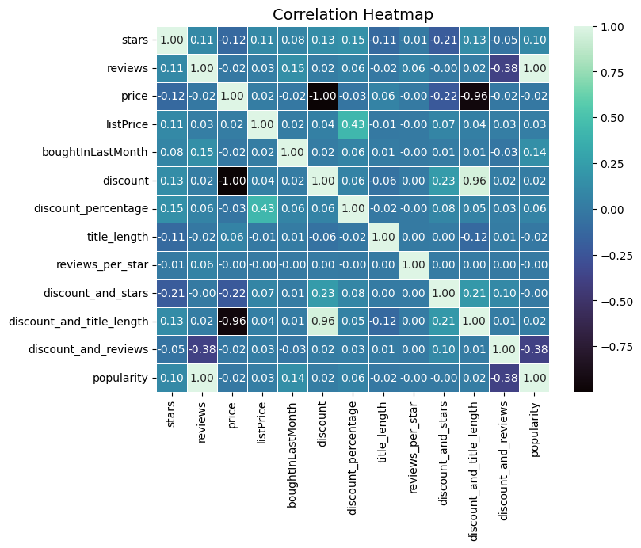
Data Preprocessing & Feature Engineering
Notes:
What direction do we want to go with the recommendations system? Do we want to exclude/penalize products not bought last month? Do we want to recommend similar products so the user has more choice or do we want to recommend complementary products? Price bins.

Slide 8
Algorithms for Recommendations
Content Based with TF-IDF Vectorized
TF-IDF (Term Frequency-Inverse-Document-Frequency) recommends item based on item content.
-> KNN and FAISS
Content Based with Transformer BERT
Built with Bert to create embeddings on item content. Then used K-nearest neighbors (KNN) to assemble the recommendations using the closest data points in the feature space.
Collaborative with AutoEncoder
Deep learning approaches leverage neural networks to enhance recommendation accuracy by capturing complex patterns in data.
Advantages:
Simple to implement.
No need for user interaction data to start making recommendations.
Disadvantages:
Recommendations can be overly specific and lack diversity (the "filter bubble").
Requires high-quality and well-structured content data.
Advantages:
More accurate and nuanced recommendations due to BERT's superior language understanding.
Can capture subtle relationships between items that TF-IDF might miss.
Disadvantages:
Computationally more expensive than TF-IDF.
Requires a large amount of training data (although pre-trained BERT models can be fine-tuned).
Advantages:
Can discover unexpected relationships between items that are not apparent from content alone.
Can personalize recommendations to a great degree.
Disadvantages:
Suffers from the "cold start" problem: difficult to make recommendations for new users or new items with no interaction history.
Requires a substantial amount of user-item interaction data to train effectively.

Slide 9
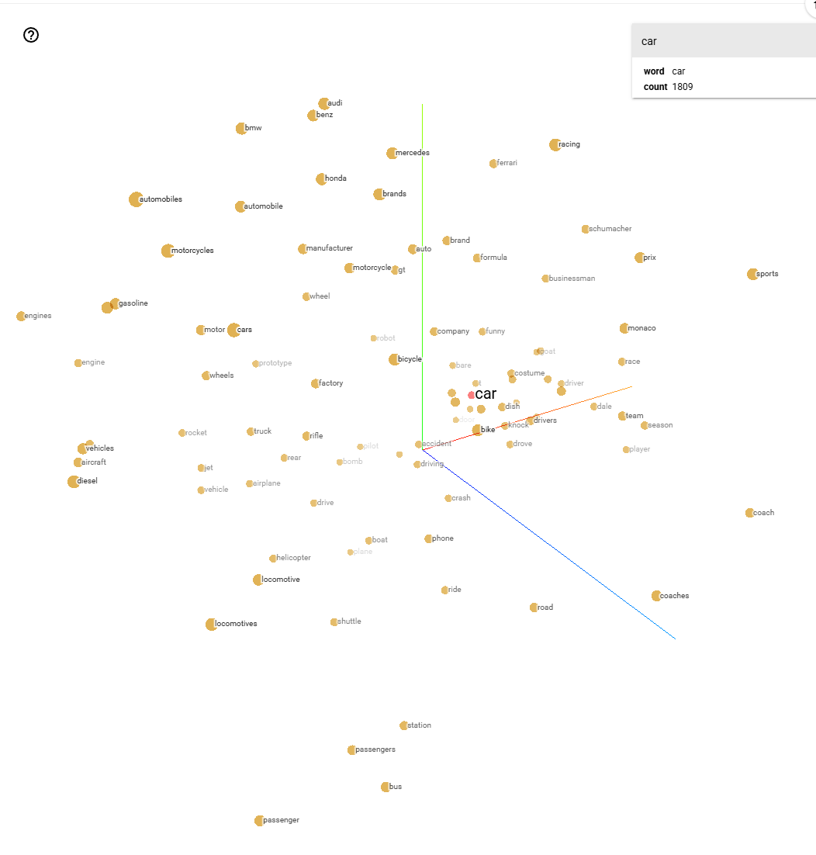
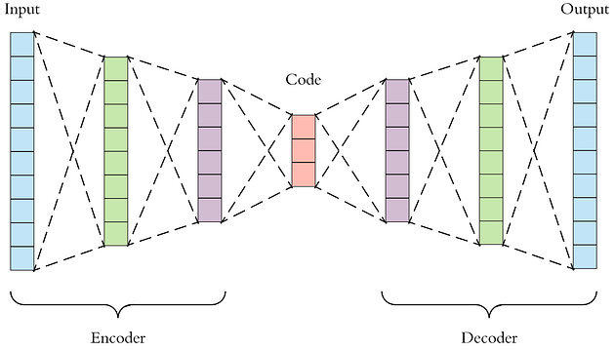
How It Works
How it works:
Product descriptions and features are converted into numerical vectors using TF-IDF.
TF-IDF measures a word's frequency in a description (Term Frequency) and its overall rarity (Inverse Doc Frequency).
Cosine similarity and other metrics are used to compare item vectors, finding items with similar content.
How it works:
An AutoEncoder is trained on a user-item interaction matrix, where users are rows, items are columns, and cells show ratings or interactions.
It compresses this matrix into a lower-dimensional representation that identifies user preference patterns.
This compressed form is used to reconstruct the original matrix and predict missing interactions, thereby recommending items that a user may enjoy.
How it works :
BERT is a deep learning model trained to grasp language context and subtleties.
Processes product desc. to create detailed vector representations (embeddings).
Embeddings reflect semantic, helping the system recognize word and concept relationships.
Item similarity done by comparing their BERT embeddings.
https://projector.tensorflow.org/

Slide 10
Install FAISS + Libraries
AutoEncoder
Norm
Import + Install Libraries
PyTorch Deep Learning Unsupervised
Distance Normalization
Plots
Hybrid I
Hybrid II
EDA
Merged Weighted
FE
BERT
SVD
Norm
Export
Pre-Trained BERT -> Embeddings
Dimensionality Reduction
Distance Normalization
New features
Text Pipeline
Filtering out
Scaling
TF-IDF
SVD
Norm
ContentBased Text Vectors
Dimensionality Reduction
Distance Normalization

Slide 11
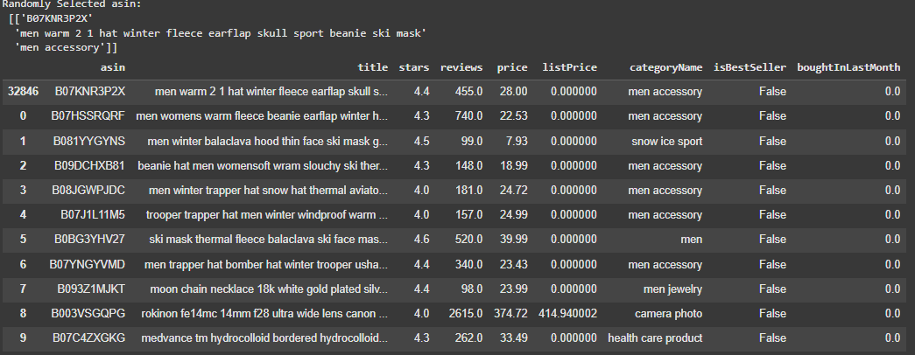
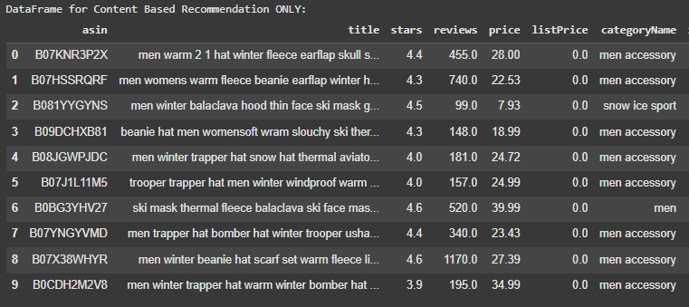
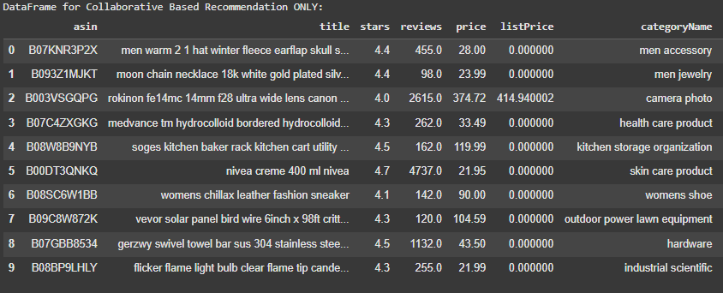
Hybrid Model – Results - Metrics
Business Metrics:
Coverage and Diversity
[Content-based] coverage = 0.999
[Content-based] diversity = 0.215
[Collaborative] coverage = 0.999
[Collaborative] diversity = 0.13
Weight 0.75
Weight 0.25

Slide 12

Fairness & Scaling up
Bias in Algorithms
It is essential to identify and mitigate bias in algorithms to ensure fair recommendations for all users. “Fairness” in models.
Scaling up
FAISS -> KNN on GPUs
EC2 -> Sagemaker Endpoint
DSSTNE with AWS

Slide 13
END

